Slide 1
2025 DKSH Internship Program
Arnold Liao
Specialist, Human Resources
Taipei, April 22, 2025

Slide 2
Agenda
公司簡介
實習職缺
薪資福利
Q&A

Slide 3
公司簡介

Slide 4
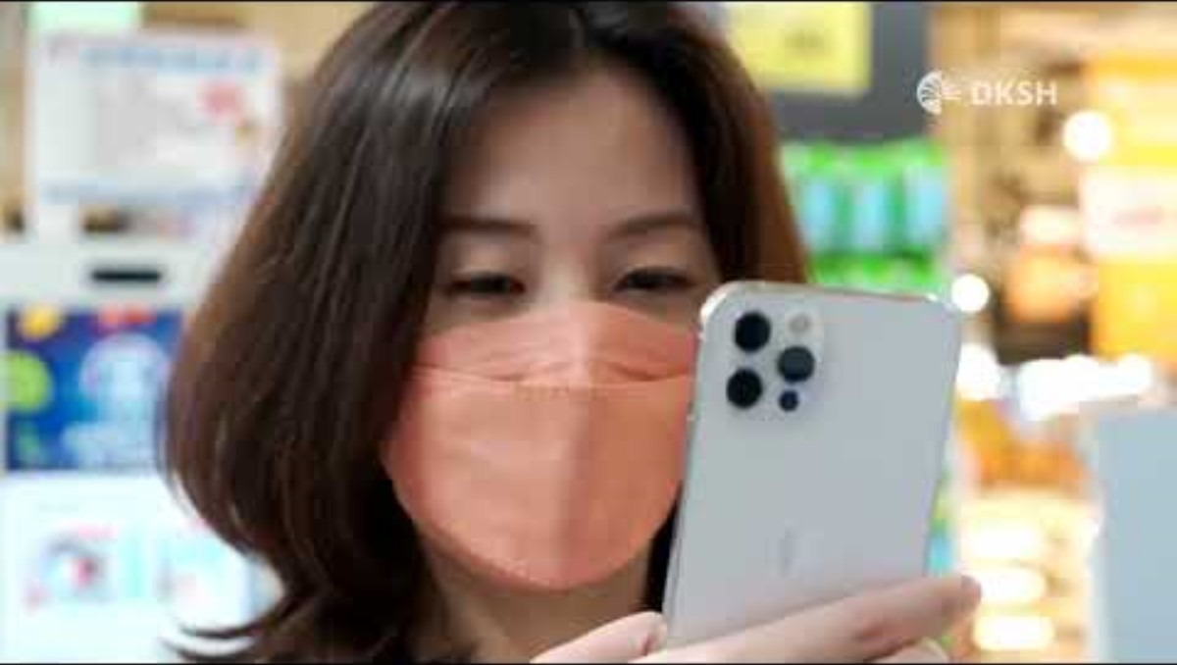

Slide 5
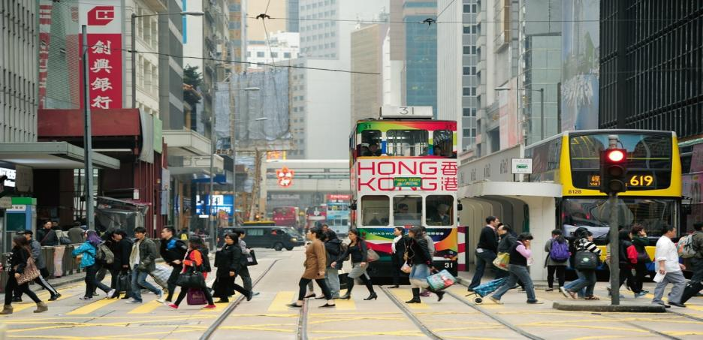
Who we are
大昌華嘉是全球市場拓展服務的領導者
We help companies to grow their business
in new and existing markets
Notes:
大昌華嘉是一個什麼樣的公司?提供服務是市場拓服務的領導者，大家都工作一段時間，知道我們是廠商跟客戶之間的橋樑。提供服務相當多樣化，我們為客戶量身訂做的服務給客戶，採購、分析、行銷、業務，售後服務，不同商業模式也會有不同的搭配，有些前端引進台灣，有些是後端銷售
Core slide

Slide 6
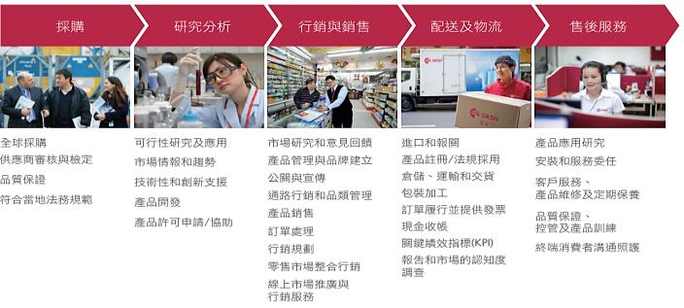





沿著價值鏈完整的服務組合
Market Expansion Services goes beyond offering individual services – it is about the integration of many different services to meet the needs of business partners
供應商 / 客戶
顧 客
採購
研究分析
行銷及銷售
物流及配送
售後服務
量身訂做、整合性的服務組合
整合的IT平台，可將顧客資訊及分析提供給上游供應商/客戶
Notes:
大昌華嘉是一個什麼樣的公司?提供服務是市場拓服務的領導者，大家都工作一段時間，知道我們是廠商跟客戶之間的橋樑。提供服務相當多樣化，我們為客戶量身訂做的服務給客戶，採購、分析、行銷、業務，售後服務，不同商業模式也會有不同的搭配，有些前端引進台灣，有些是後端銷售
We provide a comprehensive package of services – Market Expansion Services goes beyond offering individual services – it is about the integration of many different services to meet the needs of our business partners
As you can see, our services range from sourcing to after-sales and therewith cover the whole value chain of our business partners
MES allows our clients to focus on their core competencies like Research & Development, global marketing and production and use DKSH as their trusted partner to outsource marketing, sales and distribution of their products across Asia
Sourcing: our unique sourcing network offers access markets in 37 countries and a deep industry expertise enables us to provide any specialty chemicals and ingredients our business partners need
Market analysis and research: we provide market entry strategies. With our application, formulation and product development laboratories, we generate new product ideas, develop and customize them. Moreover, we turn our market insight into strategic advice for our business partners
Marketing and sales: we offer various marketing and sales services for different products and service for all relevant channels, customers and outlets to help our business partners grow their business. Our capillary distribution capability ensures increased market shares for our clients
Distribution and logistics: with our unmatched logistics infrastructure and distribution centers, we can transport, store and distribute products efficiently and professionally and we also handle cash collection
After-sales services: we offer a broad range of after-sales services and support, which ensure top quality standards, fast problem resolution and the ability to establish a high-value image

Slide 7





DKSH 是產業成功的領導者
No. 1
專注亞洲的
市場拓展服務公司
2,200客戶
2,100供應商
2,400萬筆
每年交易量
瑞士法郎 11.3 billion營收淨額 (2022)
>10 years
4 國家
平均與客戶的關係⁽¹⁾
870
營業據點
32,600
員工
超過
160 年在亞洲
550,000
顧客
¹ Top 200 clients by net sales
Notes:
We are the clear No. 1 in our industry…. blanket covering Asia with 850 business locations. Another 20 offices across Europe and the Americas support that business
With our unique capillary distribution system, we serve more than 550,000 customers across Asia based on exclusive distribution contracts with 2,000 clients and 2,000 suppliers globally
On average, clients work with us in four markets and for more than ten years
With 32,450 specialists on the ground in the regions, we manage products and market information flows across three continents, supported by a standardized IT platform which processes around 24 million transactions a year
In 2020, we generated net sales of 10.7 billion Swiss Francs
We have been truly at home in Asia for more than 150 years

Slide 8


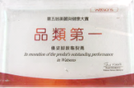





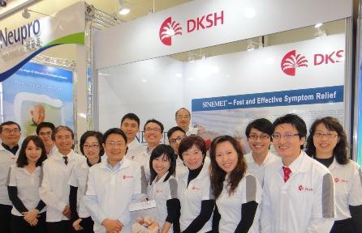










醫療保健
Healthcare
…提供您醫療保健業拓展市場的整合性服務
商業服務
配送 & 物流
商品法規
市場行銷
銷售
店頭陳列
通路管理

Slide 9
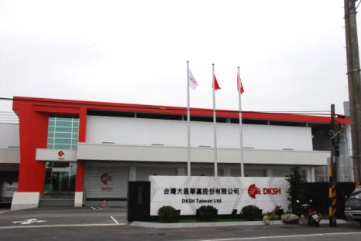









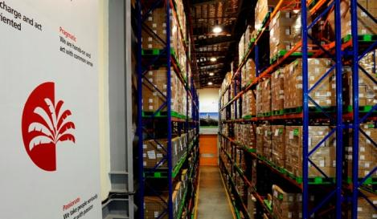








醫療保健
Healthcare
…提供您醫療保健業拓展市場的整合性服務
商業服務
配送 & 物流
標案管理
代收帳款
客戶服務中心
其他加值服務
 | 4,000+ 配送點
 | 30,000+ 平方公尺 倉儲空間
 | 48+ 供應商 21,000+ 顧客

Slide 10



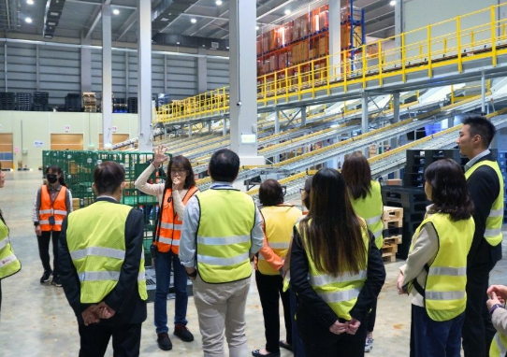
台灣營業據點
★工作地點
台北, 總部
 | 13 營業據點
 | 12 物流中心 & 倉庫
 | 460 物流車輛
 | 35,000 配送點
新竹, 分公司
(TEC)
桃園,醫療保健物流中心 (1個廠區)
桃園, 消費品物流中心 (共3廠區)
台中, 分公司
(HEC, HCL, TEC)
花蓮, 服務中心
(TEC)
台南, 分公司
(TEC)
高雄, 分公司
(HEC, FMCG, HCL, TEC)

Slide 11
實習職缺

Slide 12
實習職缺台北總公司
台北總公司
訂單相關部門實習
09:00 ~ 18:00 (前後1hr)
訂單作業
接聽客戶來電
解決客戶需求
排除/追蹤訂單問題
跨部門溝通

Slide 13
客服職涯
依線上情況與原廠窗口溝通協調，確保行政流程正確與公司權益無虞
確保一、二線人員工作品質達到組織目標、客服團隊管理與重大案件授權等
一線客服/訂單人員
單一原廠服務
客服主任
二線客服/訂單人員
專案主管
中高階主管
專案管理人員
SAP系統
行政流程
訂單／客訴
業代／通路
實習

Slide 14





薪資與福利
薪資 30,000 / 月
台北總公司 客戶服務部
勞、健、團保
每月有薪返校假 (公假)
三節禮金
旅遊補助
生日禮金
員購福利
精品咖啡
實習結束後轉任正職者年資可累計

Slide 15
Connections
Q&A

Slide 16
Thank you for your attention

